Slide 1
Entity Relationship Model
Entity Sets
Relationship Sets
Mapping Constraints
Keys
E–R Diagram
Design of an E-R Database Schema
Reduction of an E-R Schema to Tables

Slide 2
Entity-Relationship Diagrams
Developed by Peter Chen.
Purpose:
  To facilitate database design by allowing the designer to express the logical properties of the database in an enterprise schema.
  An enterprise schema is a description that corresponds to the conceptual level.
  It is valid for any kind of DBMS and will remain correct even if the DBMS is changed.
  The diagrams are basically design tools and documentation for the system.
  Classified as a Semantic data model since it attempts to capture the meaning and structure.

Slide 3
Representation of ER model
The items in the model represent the ‘things’ in the real-world, and the relationships between the real-world things are expressed by relationships in the model.
The environment of the model consists of
  Entities
  Attributes
  Keys
    Super Keys, Candidate Keys, Primary Keys, Foreign Keys
  Relationships
    one-one , one-many, many-one, many - many
  Dependencies
    Existence Dependency
  Aggregation and Generalization

Slide 4
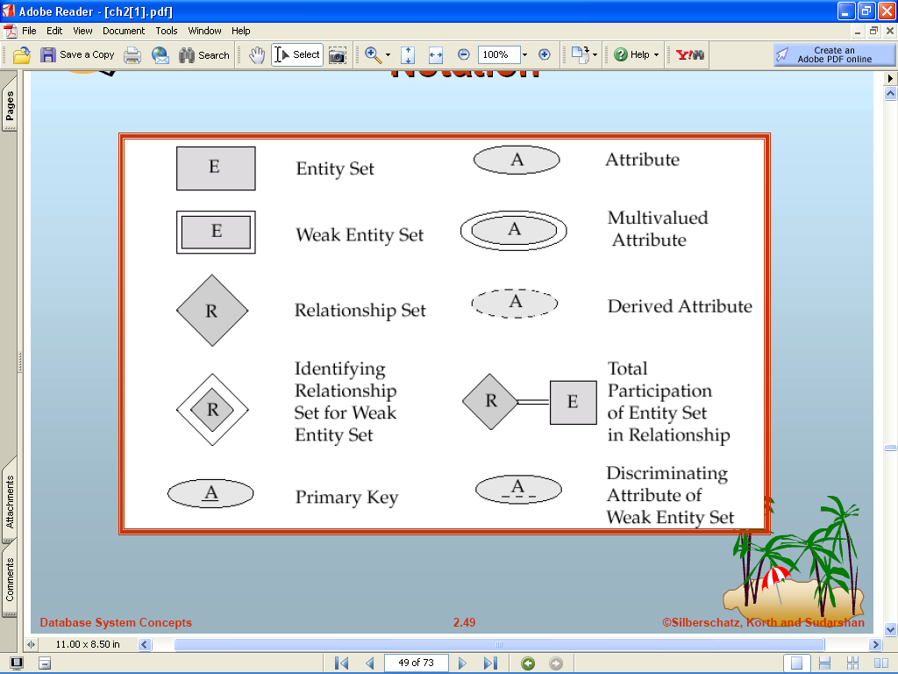
E-R Diagram Components

Slide 5
Entity Sets
A database can be modeled as:
– a collection of entities,
– relationships among entities.
An entity is an object that exists and is distinguishable from other objects.
Example: specific student, company, event
An entity set is a set of entities of the same type that share same properties.
Example: set of all students, companies etc

Slide 6
Attributes
An entity is represented by a set of attributes, that is,
descriptive properties possessed by all members of an entity set.
Example:
customer = (customer-name, social-security,
customer-street, customer-city)
account = (account-number, balance)
Domain – the set of permitted values for each attribute
Attribute types:
– Simple and composite attributes.
– Single-valued and multi-valued attributes.
– Derived attributes.

Slide 7
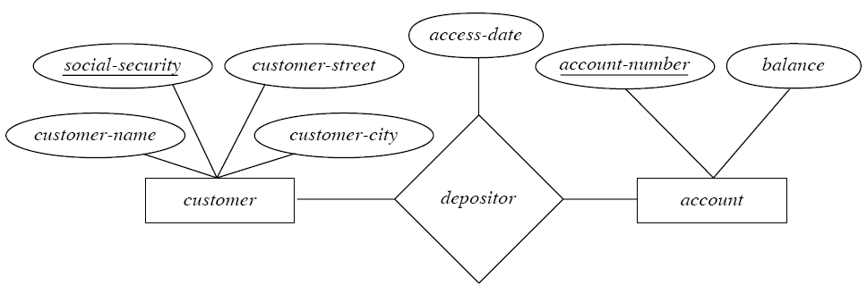
Relationship Sets
A relationship is an association among several entities
An attribute can also be a property of a relationship set.

Slide 8
Degree of Relationship Set
Refers to number of entity sets that participate in a relationship set.
Relationship sets that involve two entity sets are binary sets.
Relationship sets may involve more than two entity sets. Relationship sets that involve three entity sets are ternary sets.

Slide 9
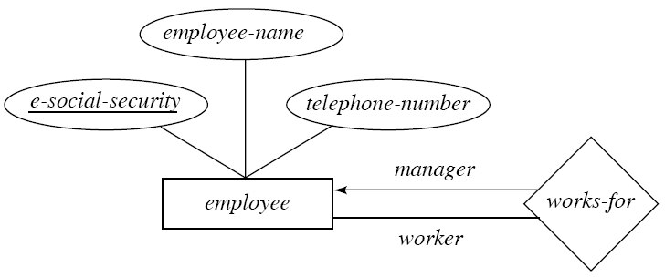
Roles
The labels “manager” and “worker” are called roles; they specify how employee entities interact via the works-for relationship set.
Roles are indicated in E-R diagrams by labeling the lines that connect diamonds to rectangles.

Slide 10
Mapping Cardinality
Express the number of entities to which another entity can be associated via a relationship set.
For a binary relationship set the mapping cardinality must be one of the following types:
– One to one
– One to many
– Many to one
– Many to many

Slide 11
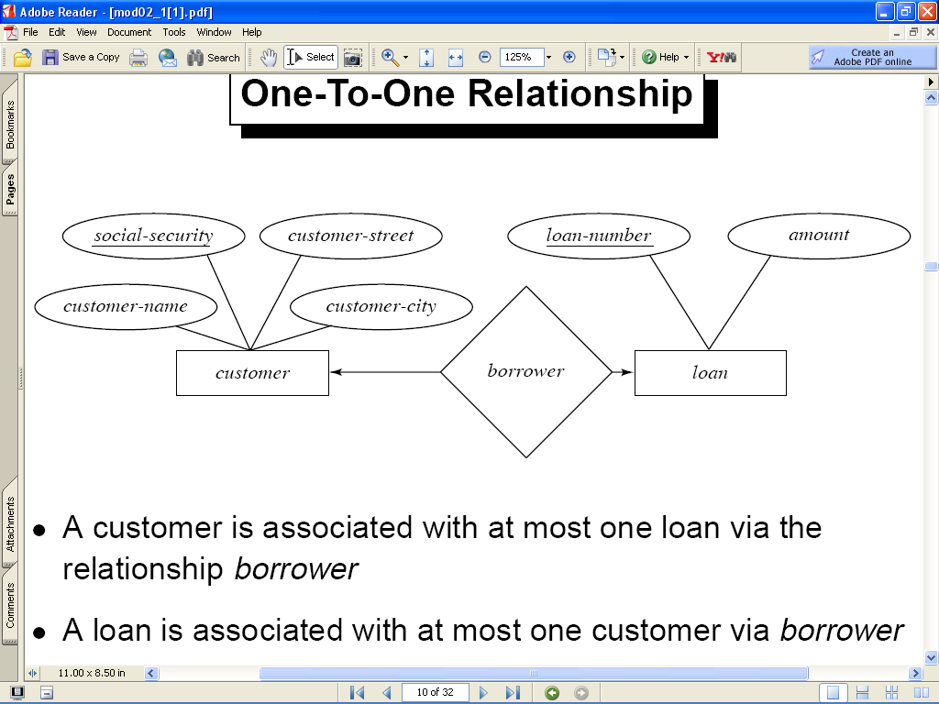
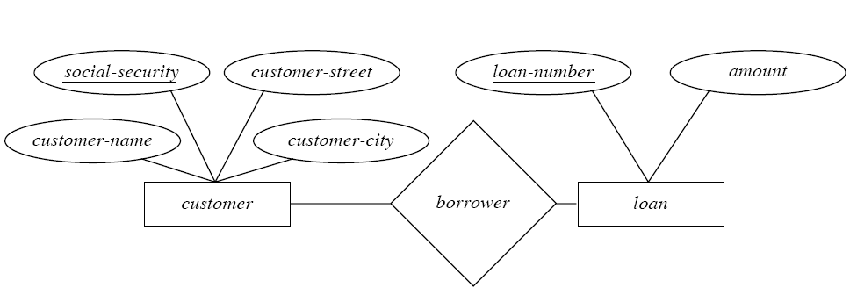
Relationships
One-One Relationship
Many - Many Relationship

Slide 12
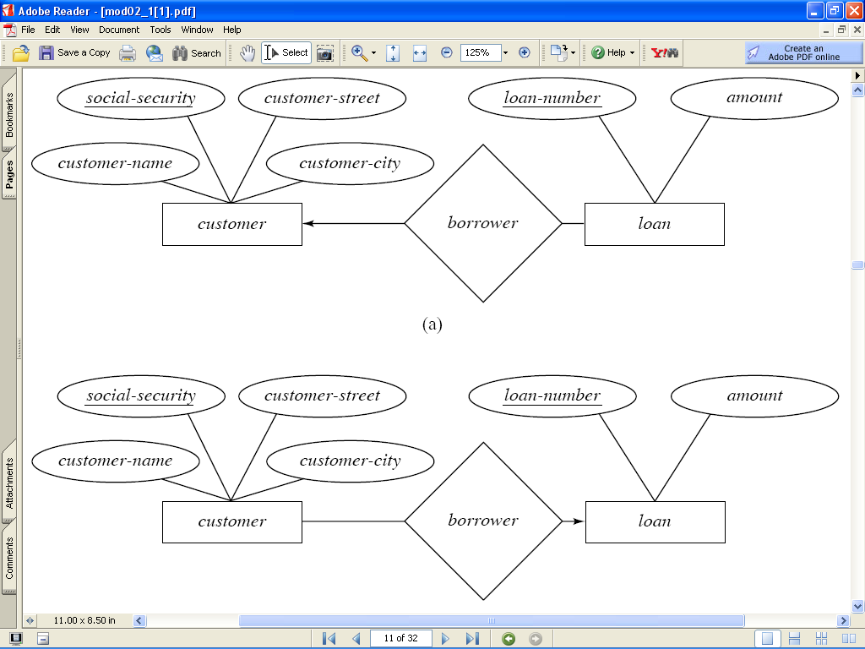
Relationships
One - Many Relationship
Many - One Relationship

Slide 13
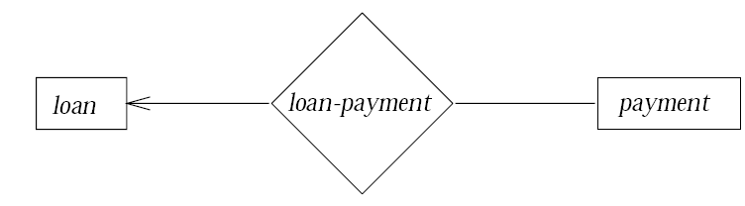
Existence Dependencies
If the existence of entity x depends on the existence of entity y,
then x is said to be existence dependent on y.
– y is a dominant entity (loan)
– x is a subordinate entity (payment)

Slide 14
Keys
Each record in a table must be unique
A super key is a column, or a set of columns, that uniquely identifies a record in a table.
A minimal super key , with no proper subset that is also a super key, is called a candidate key.
A key consisting of more than one column is called a composite key.
A primary key is the candidate key that is selected by the database designer, to uniquely identify records within the table.
– the candidate keys not selected are called
alternate keys.
A foreign key is a column or set of columns within a table that is the candidate key of another table.

Slide 15
Weak Entity Sets
An entity set that does not have a primary key is referred to as a weak entity set.
The existence of a weak entity set depends on the existence of a strong entity set; it must relate to the strong set via a one-to-many relationship set.
The discriminator (or partial key) of a weak entity set is the set of attributes that distinguishes among all the entities of a weak entity set.
The primary key of a weak entity set is formed by the primary key of the strong entity set on which the weak entity set is existence dependent, plus the weak entity set’s discriminator.

Slide 16
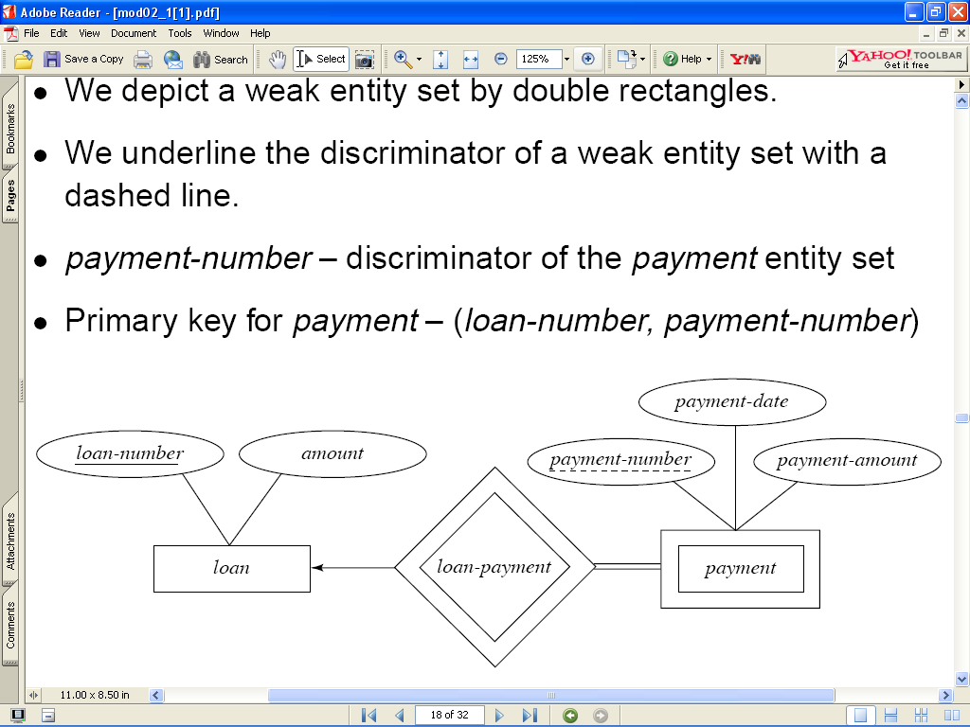
Weak Entity Set

Slide 17
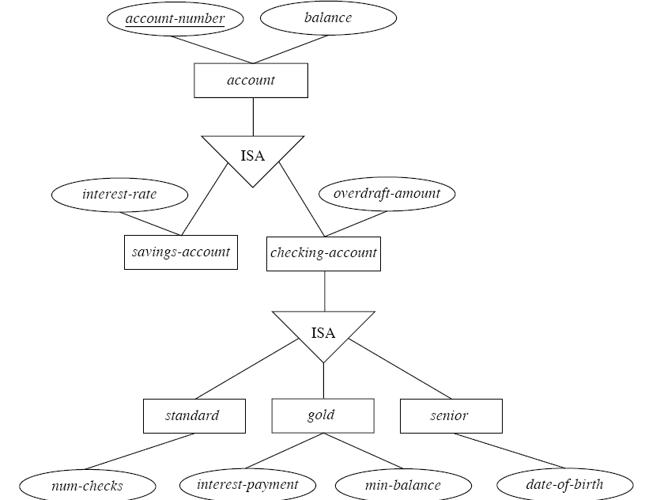
Specialization Example

Slide 18
Generalization
A bottom-up design process – combine a number of entity sets that share the same features into a higher-level entity set
Specialization and generalization are simple inversions of each other; they are represented in an E-R diagram in the same way.
Attribute Inheritance – a lower-level entity set inherits all the attributes and relationship participation of the higher-level entity set to which it is linked.

Slide 19
Aggregation
It is an abstraction of that allows us to group together objects into higher level objects.
Its inverse is decomposition, means breaking
up an object into its detailed components.
  In ERD, aggregation is represented by placing a large labeled rectangle around the objects being aggregated, whether they are entity sets alone or include relationships.

Slide 20
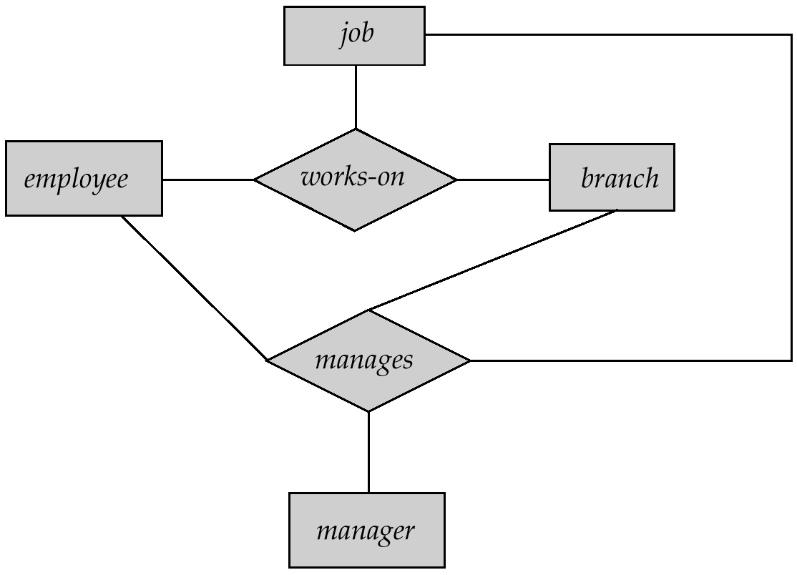
E-R Diagram With Redundant Relationships

Slide 21

E-R Diagram With Aggregation

Slide 22
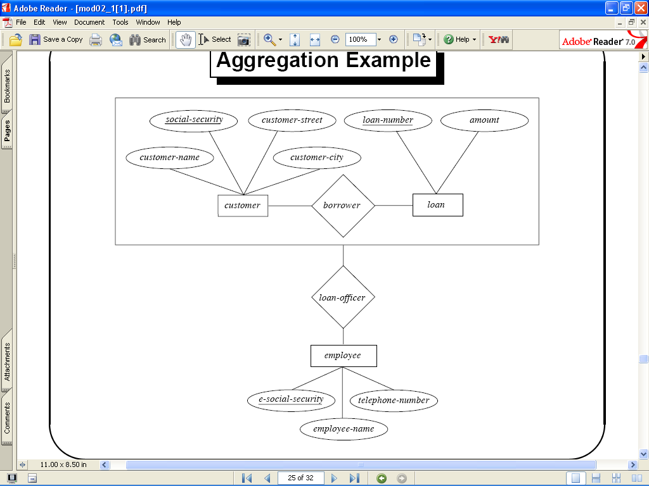
Aggregation

Slide 23
Sample ER Diagram
The entities and attributes are
Student: StuId, StuName, Address. We assume that each
student has a unique ID.Students are assigned grades based on their performance in the course.
Department: DeptName, Office. We are assuming that each
department has a unique name and that each department has
one office designated as departmental office.
Faculty: FacId, FacName,Rank. We are assuming that
FacId is unique and that every faculty member must belong to
a department, so faculty is a weak entity
Course: Course id, Ctitle,Sched, Room. We are assuming that
the course consists of an id that identifies the course uniquely. Also assuming that each course is taught by only one faculty member.
The faculty is assigned with a rank as per their performance in the course.

Slide 24
DETPNAME
OFFICE
STUNAME
STUID
DEPARTMENT
ADDR
STUDENT
ENROLL
DEPT
FACULTY
GRADE
RANK
COURSE
FACULTY
COURSE
FACULTY
COURSE ID
CTITLE
SCHED
ROOM
FACID
FACNAME

Slide 25
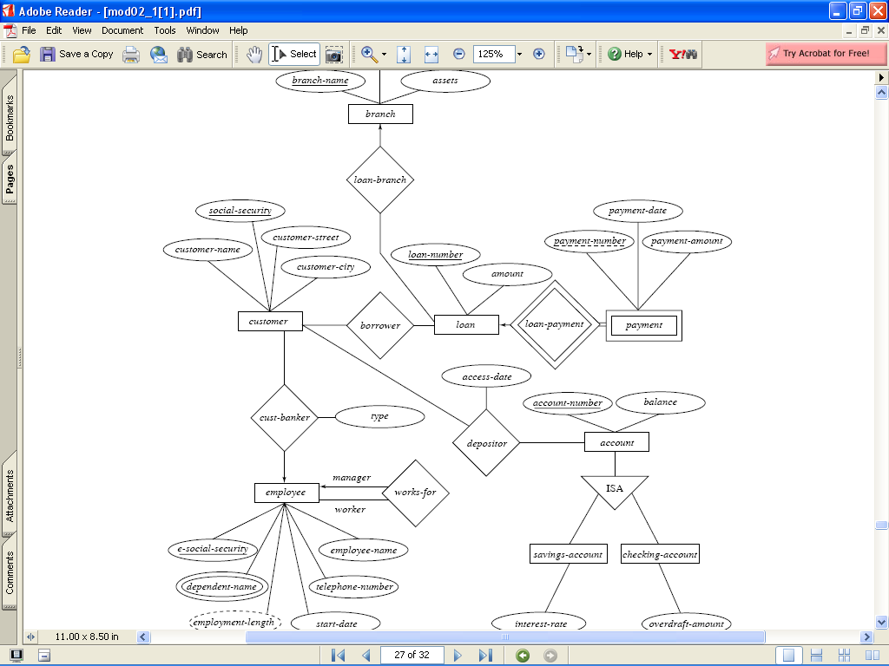
E-R Diagram of Banking Enterprise

Slide 26
Mapping an ER Model to a Relational model
The entity sets represented by rectangles become relations represented
by tables. The table name is same as the entity name written in the
rectangle.
For Strong and weak Entity sets:
  The attributes represented by ovals become attributes of the
  relations or column headings of the table.
  Tables for weak entities will have
  columns for the key attributes of the associated strong entities
  as well as for the attributes of the weak entity
For Relationship sets:
Relationship tables have columns for the primary key attributes of
related entities and a column for descriptive attribute of the relation-
ship if any. .

Slide 27
Mapping ER model - contd.,
Many-many relationships require a separate table, but one-one
and one-many relationships can often be represented by foreign
keys instead of by separate relationship tables.
When generalization is used, there may be no table for the higher
level entity, but each lower level entity table can contain columns
for all the attributes of the higher level entity in addition to
columns for their own attributes.
Alternate way is - include a table for the higher level entity that
contains its attributes, and the tables for lower level entities contain
columns for the key of higher level entity plus columns for their
own attributes.

